Slide 1






CHATBOT
NLP USING DIALOUGFLOW
Present by Daniyal Amjad
Malik Sibtain Naeem

Slide 2
KEY POINTS
01
Introduction of project
04
Project interface
02
Tools use for project
05
Project schedual
03
Diagram use in these project

Slide 3
01
NLP CHATBOT USING DIALOUGFLOW
This project is based on a chatbot use for a Grand crystal Resort

Slide 4

CHATBOT
▶This chatbot can help to make a work easier and handle a large no of orders reservations and bookings for the grand crystal resort it can provide 24/7 service to the hotel and it can also help to boost the business

Slide 5

TOOL
02
.HTML
.CSS
.JAVASCRIPT
.PYTHON.FASTAPI
.MYSQL
.GOOGLE DIALOUGFOW
.NGROK

Slide 6

TOOLS
These tools are using for the building this website the (HTML CSS AND JAVASCRIPT) use fot the frontend
PYTHON FASTAPI use for the Backend My sql use for store all data in database
Google Dialogue flow use for training the chatbot

Slide 7
Diagrams
Waterfall model Spiral model
These model are collectively call vu
process model.
01
06
Logical model class diagram
Logical model of diagram
Use case diagram
Usecase diagram of the project .
02
05
ERD diagram
ERD diagram
Architectural design
Arcitectural design of project
03
04
User interface
User interface

Slide 8

Diagrams
03
Diagrams are used to understand the project structure and flow that how project create or work .There some diagrams like ERD diagram use case diagram Architectural diagram user interface diagram etc

Slide 9
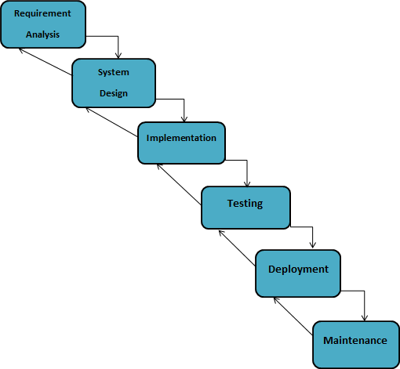
Vu water Fall model

Slide 10
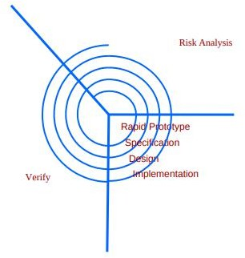
Spiral model

Slide 11
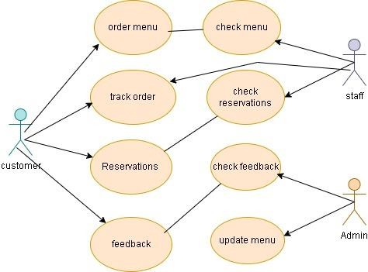
USE CASE DIAGRAM
This diagram show interaction between chatbot and users

Slide 12
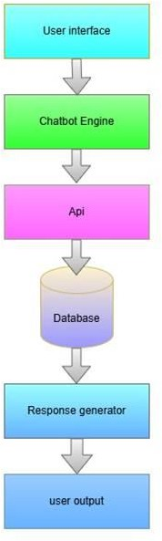
ARCHITECTURAL DIAGRAM
▶THE ARCHITECTURAL DIAGRAM SHOWS PROCESS OF CHATBOT

Slide 13
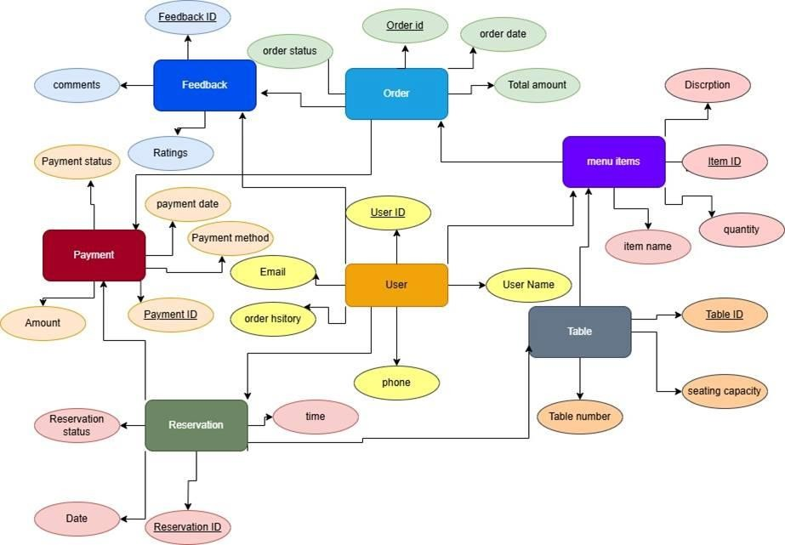
ENTITY RELATIONSHIP DIAGRAM
▶THIS DIAGRAM SHOWS THE REALTIONSHIP OF THE CHATBOT WITHE USER AND WEBSITE AND IT ALSO SHOWS THE FUNCTIONALITY OF CHATBOT

Slide 14
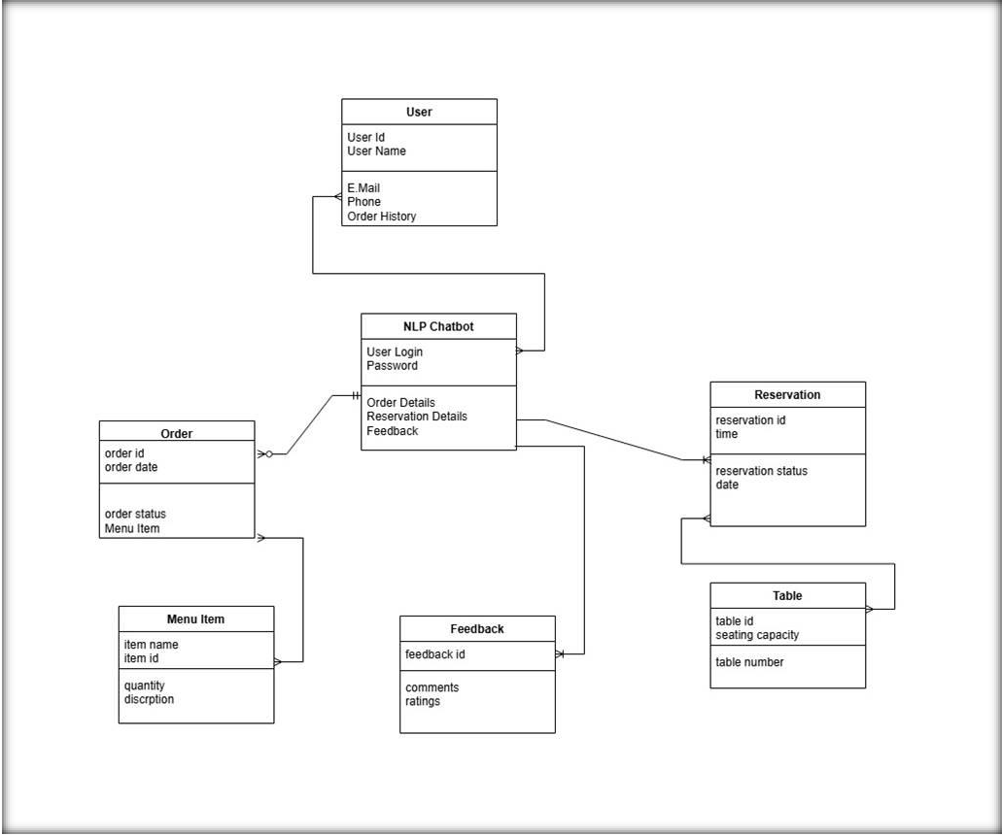
LOGICAL DIAGRAM

Slide 15
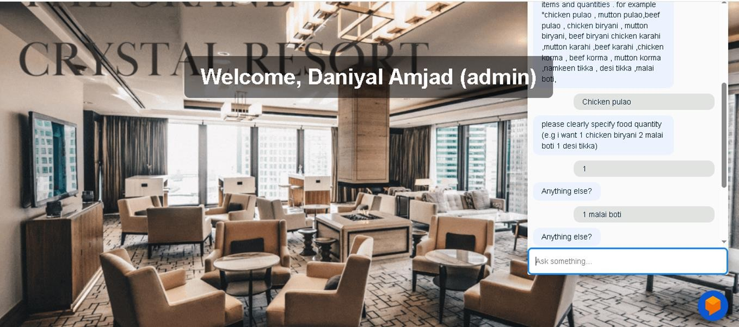
USER INTERFACE

Slide 16
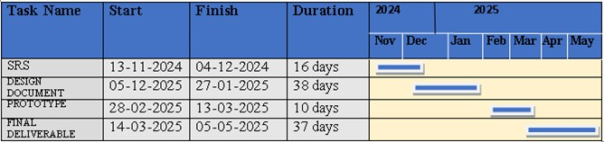
PROJECT SCHE DULE

Slide 17

Team Introductions
4
NAME: DANIYAL AMJAD ID:BC200403791
NAME:MALIK SIBTAIN NAEEM ID :BC200407809

Slide 18
Thank You

